Slide 1

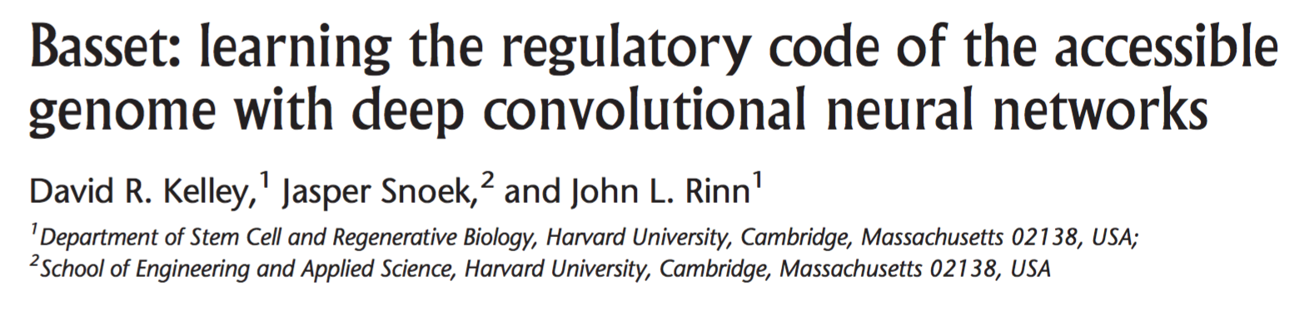
CS273B Presentation
10/19/2016
Amr Mohamed, Wisam Reid, Irán Román

Slide 2
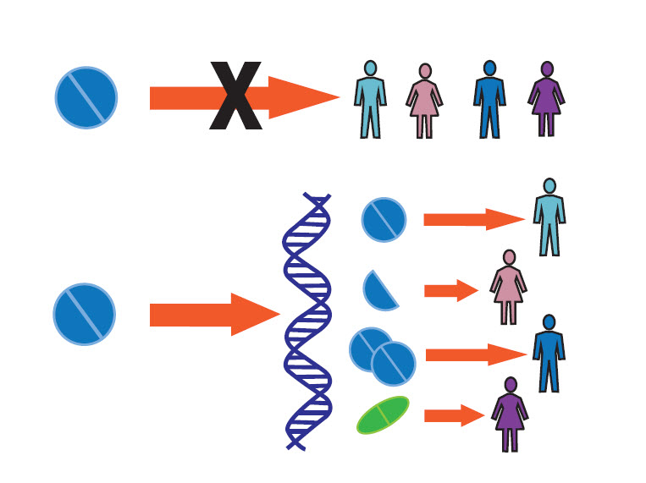
Towards Personalized Medicine
http://medicine.iupui.edu/IIPM

Slide 3
Non-coding DNA and personalized Medicine
Can we relate non-coding DNA with phenotypes?
Intron (non-coding)

Slide 4
Non-coding DNA and personalized Medicine
Large surveys indicate that these modifications are statistically related to phenotypes (ENCONDE, 2012)
Notes:
“The first stages of a mechanistic hypothesis can now be assigned to variants that directly overlap these annotations”

Slide 5
Taking full advantage of these annotations
Two possibilities:
1)
2)
GATAC . . .
Notes:
“The first stages of a mechanistic hypothesis can now be assigned to variants that directly overlap these annotations”

Slide 6
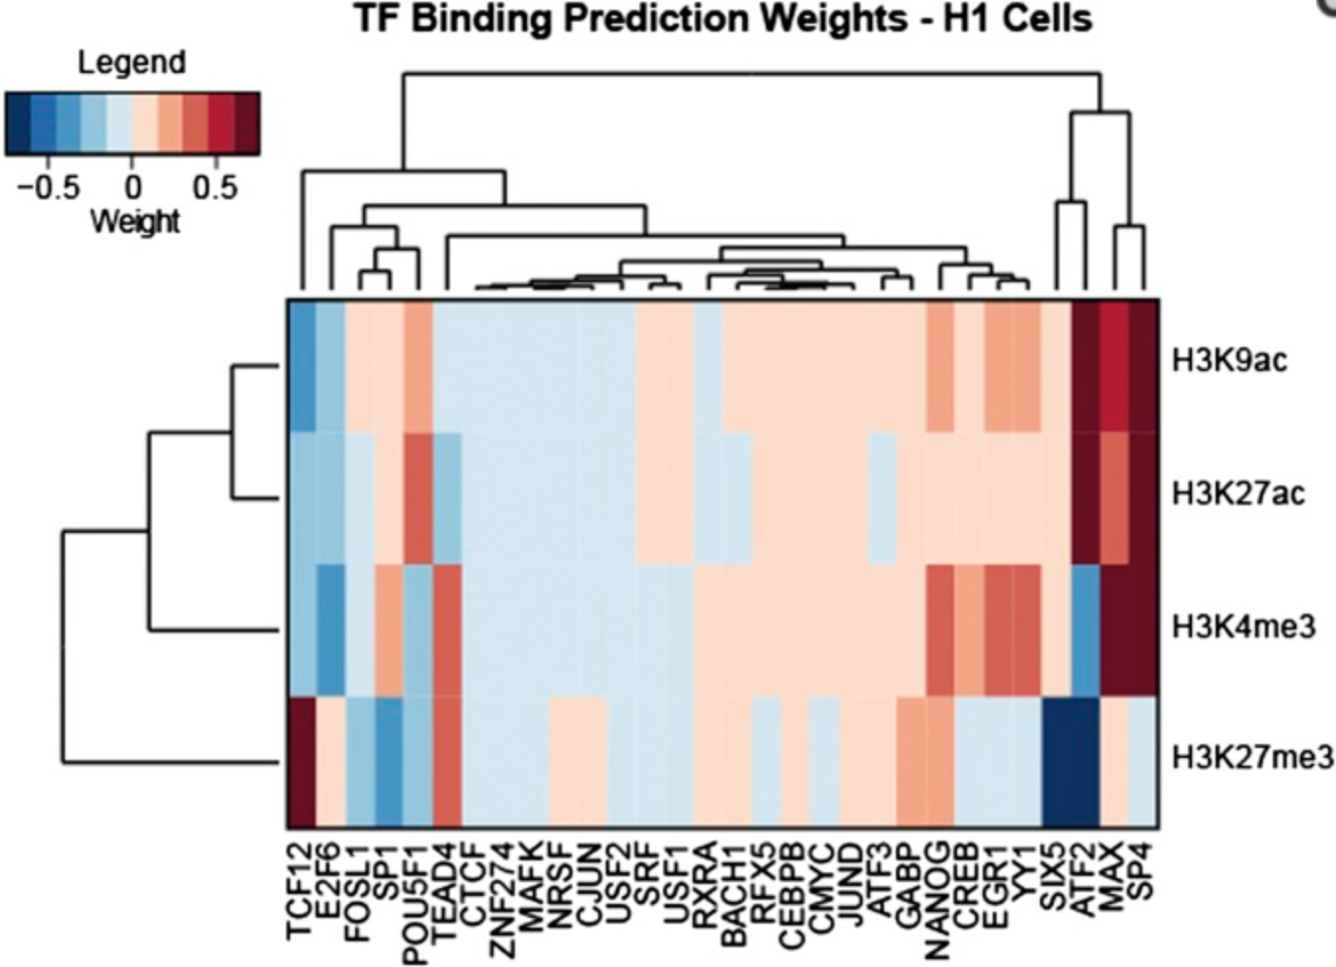
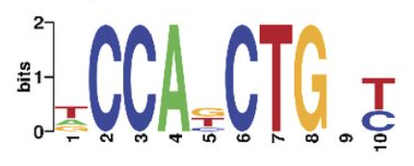
Machine Learning identifies DNA interactions
Pinello et al., 2014
Beneviste et al., 2014

Slide 7
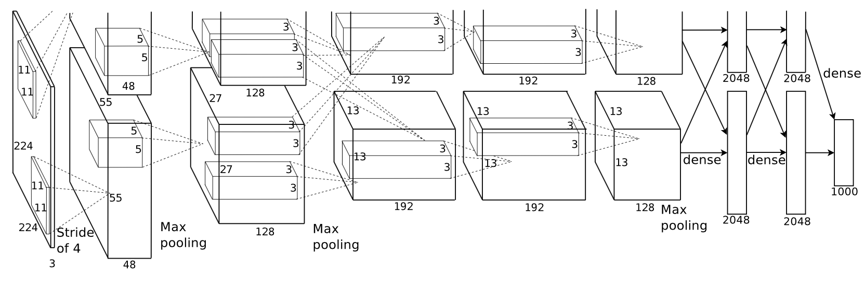
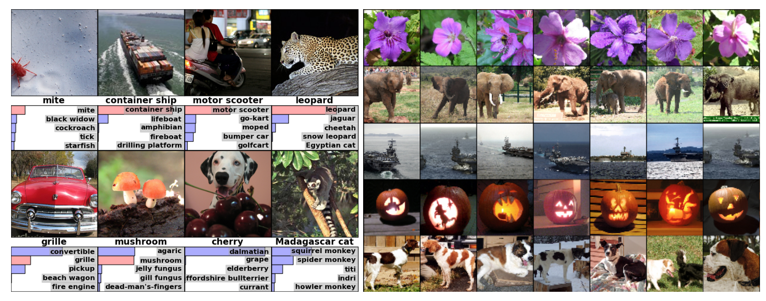
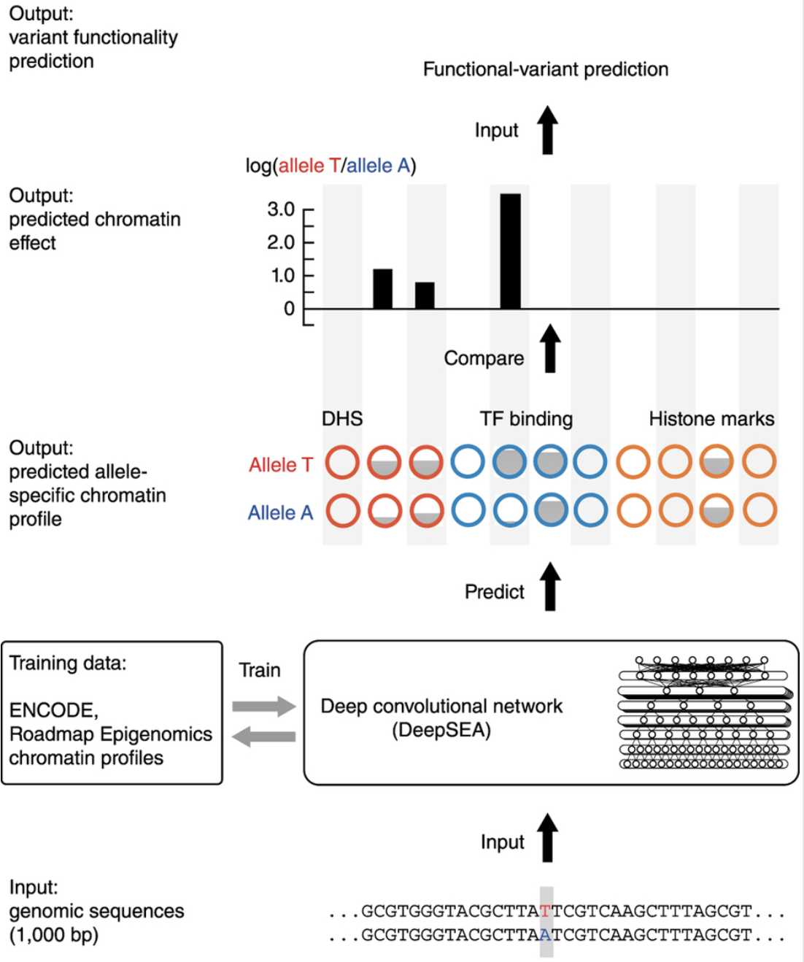
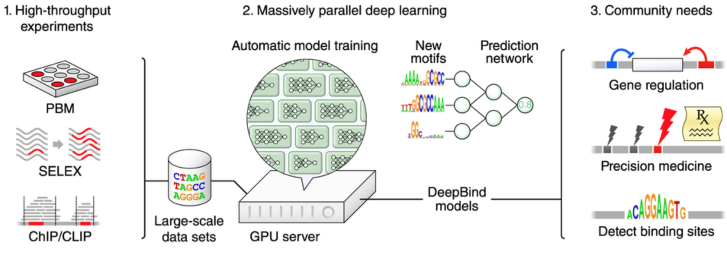
Using CNNs to Advance Genomics
Krizhevsky et al. 2012
Alipanahi et al. 2015
Zhuo & Troyanskana, 2015

Slide 8
“It is essential that [these techniques] are technically and conceptually accessible to the researchers who can take advantage of their potential.”

Slide 9
Saving the day …
Deep CNNs
Open Source
Tailored to the Biosciences community
Functional assessment of DNA
Basset

Slide 10
Benchmarks Using Basset:
Significance:
Predict the accessibility of DNA sequences in 164 cell types, as mapped by DNase-seq.
Learn the relevant sequence motifs and the regulatory logic with which they are combined to determine cell-specific DNA accessibility.
Meaningful, nucleotide-precision measurements.
Scores that reflect the accessibility difference predicted by the model between two alleles.
Highly predictive of the causal SNP among sets of linked variants.

Slide 11
The DNase I Hypersensitivity Dataset
Merge of two datasets DNase-Seq datasets from 164 cell types.
DNase-Seq
Multiple sites with 600-bp sequences and a binary vector indicating the presence of a significant peak in each of the 164 cell types.
DNase
Notes:
Yellow boxes indicate active sites.

Slide 12
Methods

Slide 13
Notes:
Basset is a very general toolbox. Users can specify number of layers, type of layers, size of filters, etc. etc.
In the paper, the authors focus on a particularly good model. We are going to take a closer look.

Slide 14
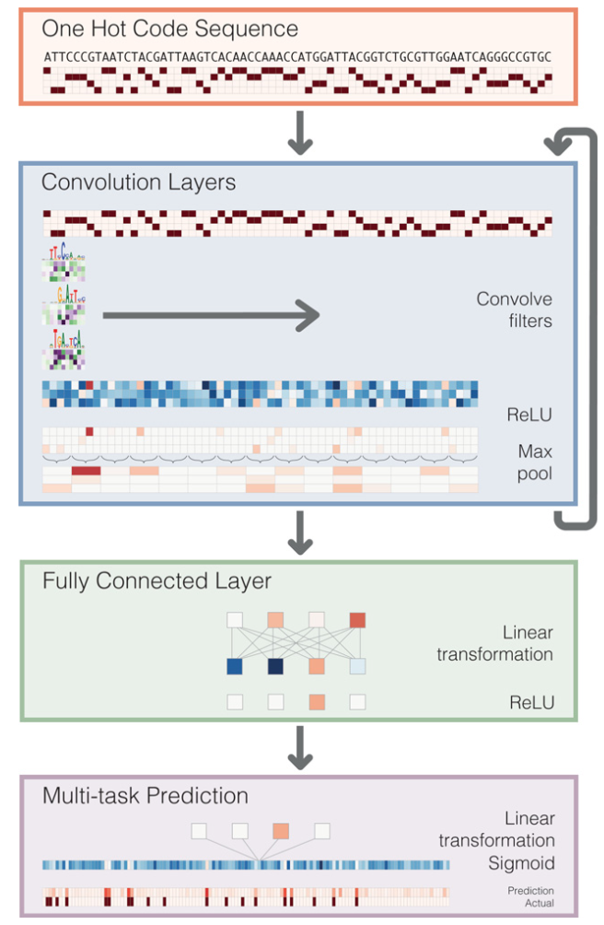
Neural Network Architecture
Convert to one hot code sequence
3x [Convolutional layer with PWMs as filters, ReLU, Max Pool]
2 standard fully connected layers
1 fully connected sigmoid to 164 outputs, representing probabilities for eh cell type.
Notes:
Convolution layers proceed by scanning weight matrices across the input matrix to produce an output matrix with a row for every convolution filter and a column for every position in the input (minus the width of the filter). We apply a rectified linear unit (ReLU) nonlinear transformation to the convolution output and pool by taking the maximum across a window of adjacent positions.
The first convolution layer operates directly on the one hot coding of the input sequence, making the convolution filters akin to the common bioinformatics tool position weight matrices. Subsequent convolution layers consider the orientations and spatial distances between patterns recognized in the previous layer. Fully connected layers perform a linear transformation of the input vector and apply a ReLU. The final layer performs a linear transformation to a vector of 164 elements that represents the target cells. A sigmoid nonlinearity maps this vector to the range zero to one, where the elements serve as probability predictions of DNase I hypersensitivity, to be compared via a loss function to the true hypersensitivity vector.

Slide 15
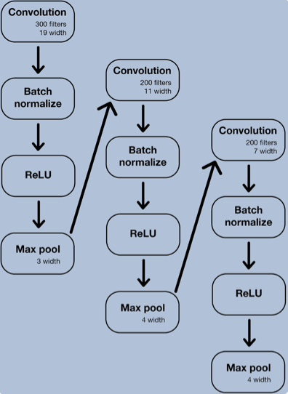
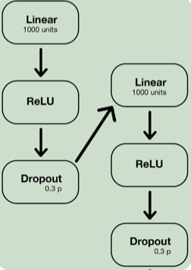
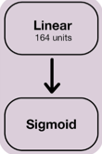
Notes:
Batch normalization alleviates a lot of headaches with properly initializing neural networks by explicitly forcing the activations throughout a network to take on a unit gaussian distribution at the beginning of the training. The core observation is that this is possible because normalization is a simple differentiable operation.
ReLU sets negative values to zero and prevents the problem of vanishing gradients.
Max Pool reduces the dimension of the inputs and gives us invariance to small shifts.

Slide 16
Data, Loss Function, and Optimizations
Example dataset: about 2 million examples total
about 70,000 reserved for testing, another 70,000 for validation
Cross entropy loss function
Initialization
Stochastic gradient descent for all parameters
RMSprop updates with mini-batches
Dropout regularization
Early stopping
Notes:
Model is trained to minimize binary cross entropy summed over 164 outputs
Parameters randomly initialized to small values not zeros to avoid getting the same updates (we want a little asymmetry)
rmsprop: Divide the learning rate for a weight by a running average of the magnitudes of recent gradients for that weight
Early stopping after 12 epochs of unimproved validation loss

Slide 17
Results
Notes:
We present five main results

Slide 18
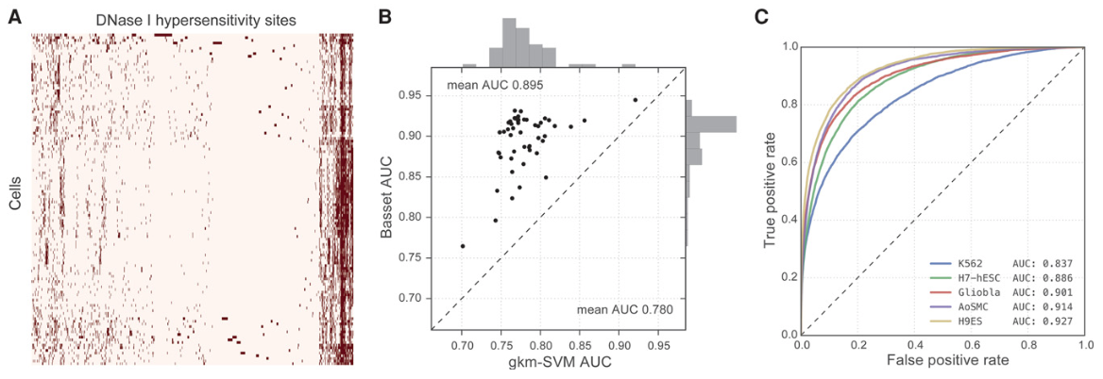
Deep CNNs predict genome accessibility
Notes:
We use the same neural net to predict cell-specific DNA accessibility
for DNA sequences, the convolutional layer will capture spatial interactions between the initial PWM filter outputs
Figure (A) The heat map displays hypersensitivity of 2 million DNase I hypersensitive sites (DHSs) mapped across 164 cell types. The columns at the end are all hypersensitive so they are accessible. Perhaps, they are used to make RNA that is used by most cells.
(B) The scatter plot displays AUC for 50 randomly selected cell types achieved by Basset and a state-of-the-art SVM model
(C) The Receiver Operating Characteristic curves display the Basset false-positive rate versus true-positive rate for five cells, selected to represent the 0.05, 0.33, 0.50, 0.67, and 0.95 quantiles of the AUC distribution.

Slide 19
Efficient Prediction using Pretraining
Notes:
Basset leverages large-scale public data to inform additional data set learning.
Goal: Identify Causal SNPs (A SNP is a variation in a single nucleotide that occurs at a specific position in the genome)
The appropriate data comes from specialized cell types which in many cases are experimentally characterized by individual labs and not large-scale mapping projects
Leveraging large-scale models allows accurate and efficient prediction of new data sets
Basset can be pretrained on public datasets

Slide 20
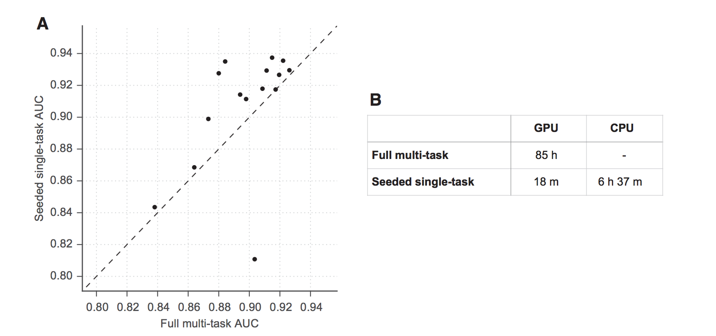
Efficient Prediction using Pretraining
Notes:
Figure (A) The scatter plot shows AUC for 15 data sets achieved by the full model trained on all 164 cell types on the x-axis and AUC achieved by a procedure to simulate studying that data set alone on the y-axis. To study the data set alone, we pre-train a model on 149 cells (after removing these 15), seed training of the additional cell with that model’s parameters, and perform a single training pass through the new data. This rapid procedure was effective for all but one data set (HRCEpiC, renal cortical epithelial cells), for which multitask training with the many other similar epithelial cells was beneficial. The AUC improvement for many cells suggests that our full model may benefit from increased capacity or decreased regularization.
(B) The seeded training procedure is far faster on the GPU and allows for feasible CPU training.

Slide 21
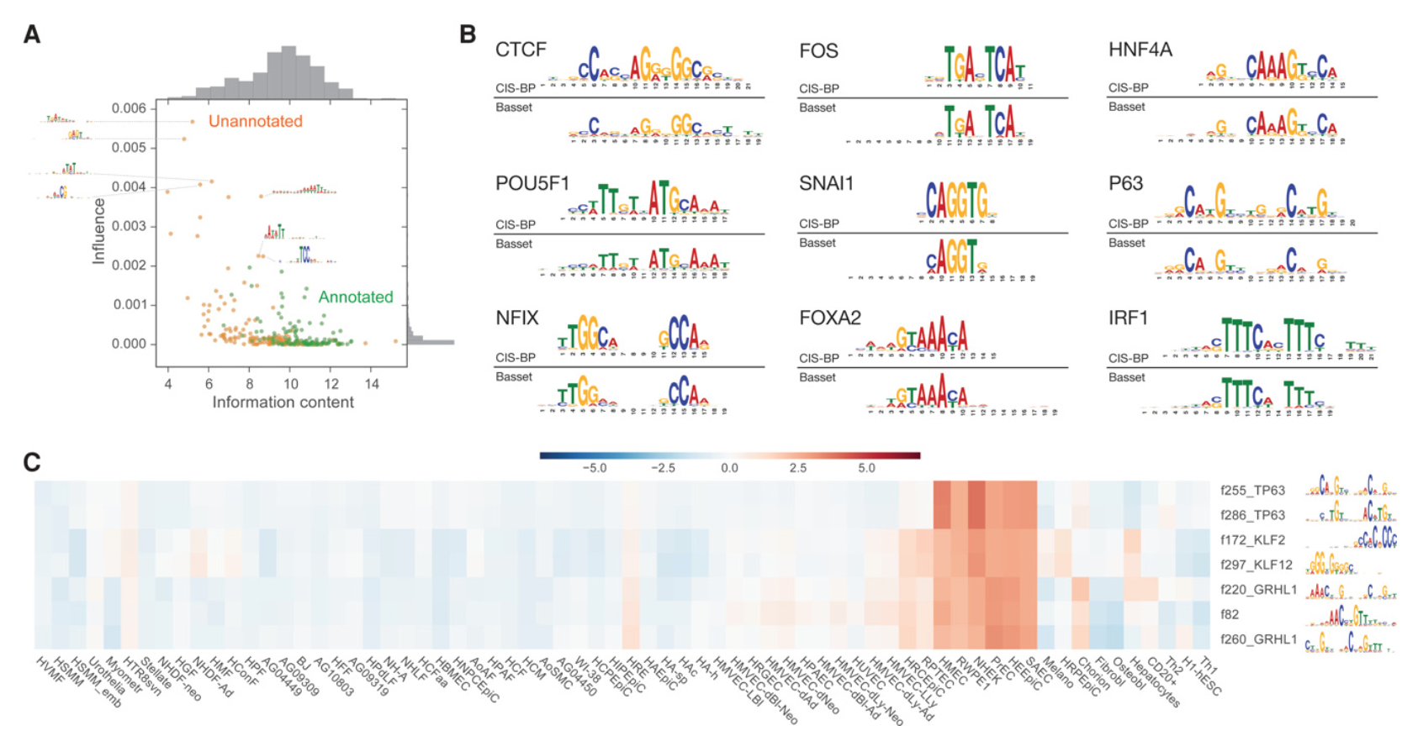
Recovery of protein binding motifs
Notes:
300 convolutional filters. 45% of filters could be annotated, including the alignments shown here

Slide 22
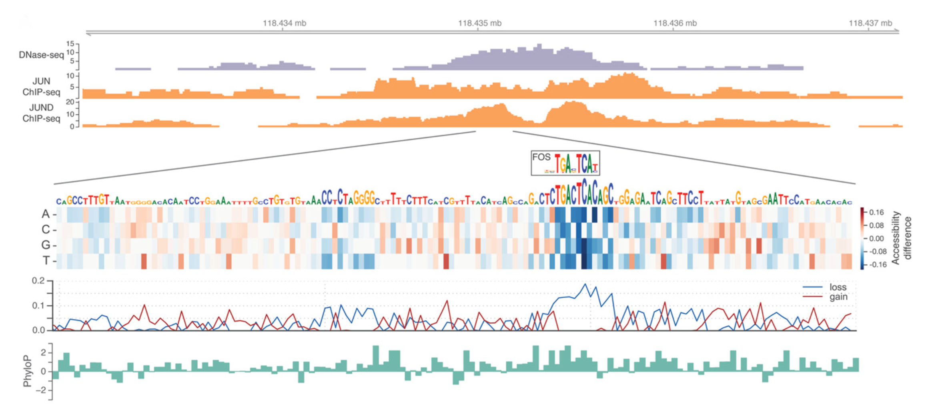
In silico saturation mutagenesis (ISSM) pinpoints nucleotides driving accessibility
Basset models can be used to predict the functional activity of arbitrary sequences, applying the regulatory grammar that it has learned using ISSM
Constructs a heat map that displays the change in predicted accessibility from all possible mutations at every position
High loss scores mark positions with existing functional motifs where mutations can damage the motif and decrease accessibility
Notes:
embryonic stem cells and contains the AP-1 (TGASTCA)
State-of-the-art experimental approaches involve a complex procedure of synthesizing massive pools of oligonucleotides and measuring their activity in a parallel reporter assay
Heat maps highlight the individual nucleotides most critical to a sequence’s activity.
We assigned two scores to every position:
(1) The loss score measures the largest possible decrease and
(2) the gain score measures the largest increase.
Mutagenesis is a powerful tool for dissecting the exact nucleotides driving a functional activity by computing the predicted accessibility of all possible mutations to a sequence
DEFINITIONS:
Mutagenesis: is a process by which the genetic information of an organism is changed in a stable manner, resulting in a mutation.
Saturation mutagenesis experiments, in which every mutation to a sequence is tested
Oligonucleotides are short DNA or RNA molecules, oligomers, that have a wide range of applications in genetic testing, research, and forensics.
Oligomers, a molecular complex that consists of a few monomer units, in contrast to a polymer, where the number of monomers is, in principle, not limited. Dimers, trimers, and tetramers are, for instance, oligomers composed of two, three and four monomers, respectively.
-------
A trained model can be used to predict the functional activity of arbitrary sequences using saturation mutagenesis experiments
Basset can be used to perform an in silico saturation mutagenesis
To highlight the individual nucleotides most critical to a sequence’s activity, we constructed heat maps that display the change in predicted accessibility from mutation at every position
High loss scores mark positions with existing functional motifs where mutations can damage the motif and decrease accessibility

Slide 23
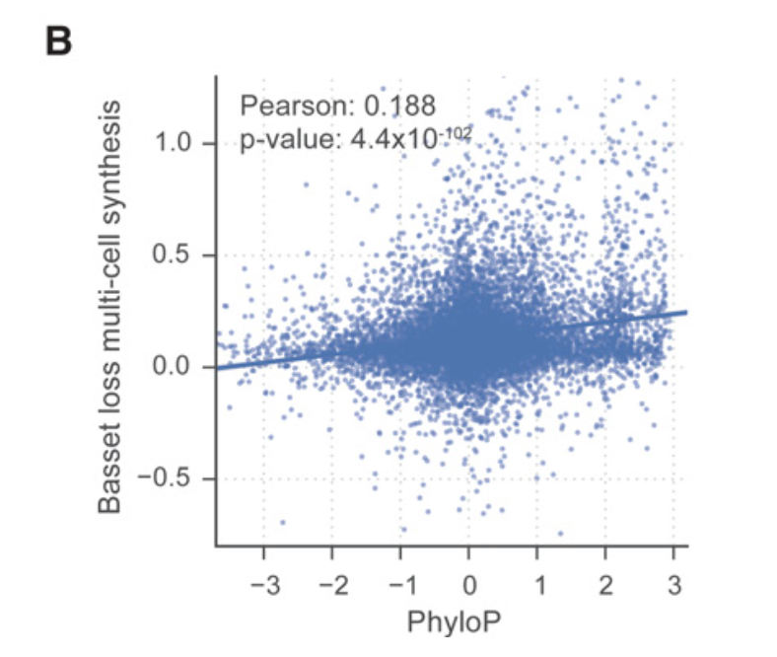
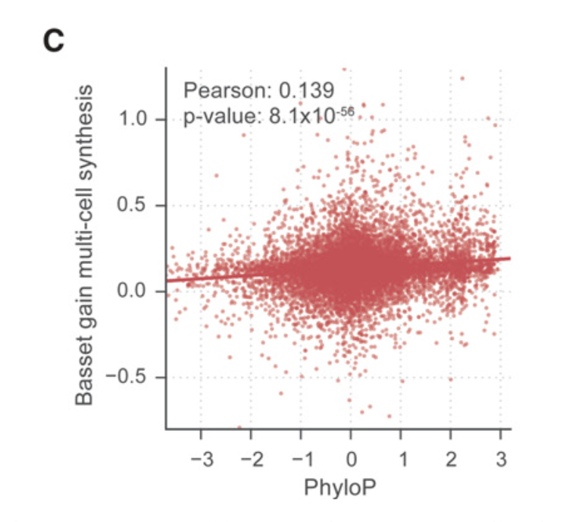
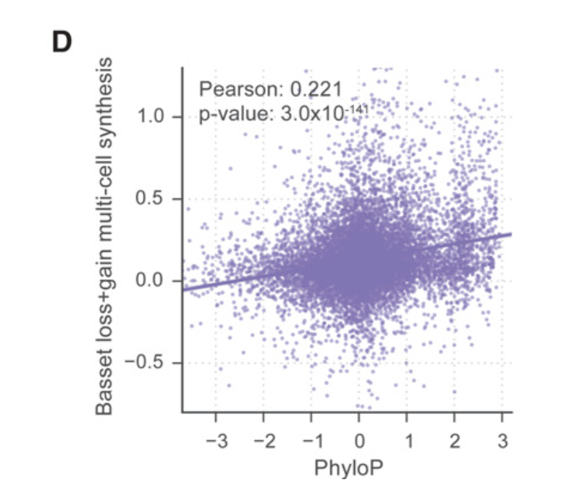
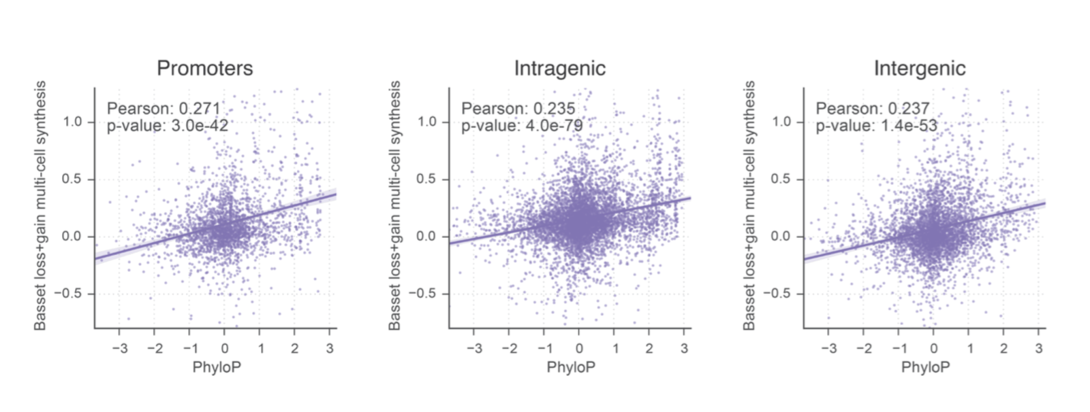
Loss scores
Gain scores
Loss + Gain scores
PhyloP conservation statistics versus Basset’s regressed multi-cell synthesis of ...
Notes:
This correlation was consistent across promoter, intragenic, and intergenic annotation classes
A promoter is a region of DNA that initiates transcription of a particular gene. Promoters are located near the transcription start sites of genes
Intragenic, a proposed designation for genetic modifications which originate in a common genome
An Intergenic region (IGR) is a stretch of DNA sequences located between genes. Intergenic regions are a subset of noncoding DNA. Occasionally some intergenic DNA acts to control genes nearby, but most of it has no currently known function.

Slide 24
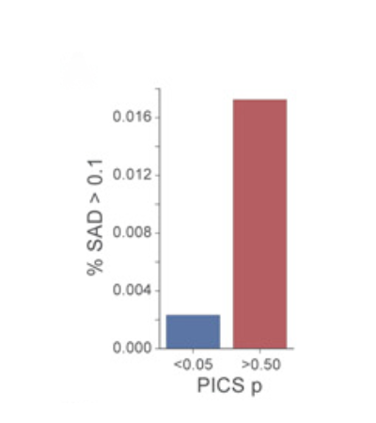
Basset predicts greater accessibility changes for likely causal GWAS SNPs
Genome-wide association studies (GWAS) have uncovered ample noncoding variants associated with physical traits and disease in human populations.
A set of 7252 non-coding GWAS SNPs associated with auto-immune disease were analyzed with a statistical method called PICS
Notes:
PICS: probabilistic inference for ChIP-seq
leverages dense genotyping data to assign a probability of being the causal SNP among a nearby set of SNPs in linkage disequilibrium (LD)
Basset captures the sequence signals driving accessibility and ought to have predictive power for prioritizing noncoding variants and suggesting mechanistic hypotheses for further investigation into their causal role for the phenotype.
We defined SNP Accessibility Difference (SAD) profiles as the difference in predicted accessibility across cell types between two alleles. The scarcity of confirmed positive examples of noncoding causal variants challenges a thorough assessment of the value of SAD scores for GWAS prioritization.
DEFINITIONS:
DHSs (DNase I hypersensitive sites): regions of chromatin that are sensitive to cleavage by the DNase I enzyme. In these specific regions of the genome, chromatin has lost its condensed structure, exposing the DNA and making it accessible.
SNPs: Single nucleotide polymorphisms, frequently called SNPs (pronounced “snips”), are the most common type of genetic variation among people. Each SNP represents a difference in a single DNA building block, called a nucleotide. For example, a SNP may replace the nucleotide cytosine (C) with the nucleotide thymine (T) in a certain stretch of DNA.
Vitiligo (vit-ih-LIE-go) is a disease that causes the loss of skin color in blotches. The extent and rate of color loss from vitiligo is unpredictable. It can affect the skin ...

Slide 25
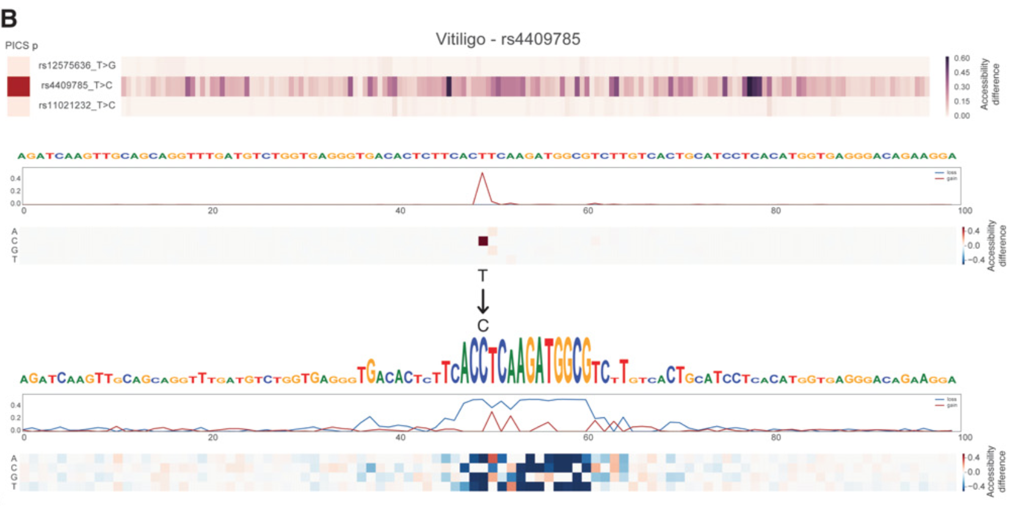
Basset predicts greater accessibility changes for likely causal GWAS SNPs
Among the agreements with PICS was rs4409785, associated with vitiligo, rheumatoid arthritis, and immune mechanisms in multiple sclerosis
It has been hypothesized to regulate TYR, which offers a plausible mechanism for the skin color disease vitiligo.
Notes:
By modeling the underlying sequence driving the experimental measurement, Basset’s highlight of rs4409785 suggests a functional hypothesis to accelerate study of this widely influential variant.

Slide 26
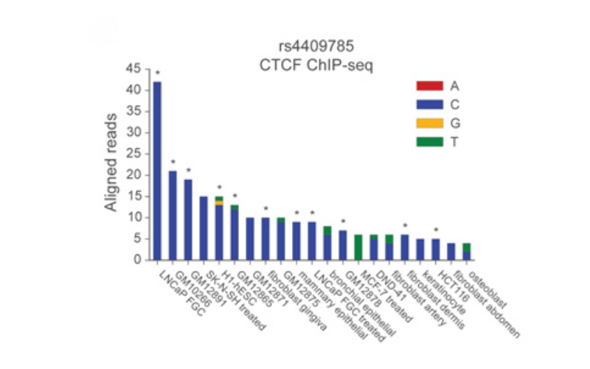
Basset predicts greater accessibility changes for likely causal GWAS SNPs
Notes:
By modeling the underlying sequence driving the experimental measurement, Basset’s highlight of rs4409785 suggests a functional hypothesis to accelerate study of this widely influential variant.

Slide 27
Discussion
Basset is an open source package to apply deep CNNs to learn DNA sequence activity.
Effectively learns the complex code of DNA accessibility across many cell types and substantially surpasses the predictive accuracy of the present state of the art.
NNs trained via stochastic gradient descent scale very well to large data sets, allowing us to learn good parameters within a general and expressive model structure.
Researcher can learn a cell’s chromatin accessibility code and annotate every mutation in the genome with its influence on present accessibility and latent potential for accessibility with just a single sequencing assay in their cell type of interest
Notes:
CNNs naturally consider positional relationships between sequence signals
neural networks trained via stochastic gradient descent scale very well to large data sets, allowing us to learn good parameters within a general and expressive model structure.
Basset implicates the precise nucleotides influencing accessibility, providing a finer-resolution view than mere overlap with a broad region.
a researcher can perform a single sequencing assay in their cell type of interest and simultaneously learn that cell’s chromatin accessibility code and annotate every mutation in the genome with its influence on present accessibility and latent potential for accessibility

Slide 28
Caveats
TensorFlow is becoming the standard for Neural Network development and Basset does not use it.
Only trained on DNase-seq data which doesn’t capture epigenetic effects
The paper seems to be very exploratory and its case studies often leave much to be further researched.
Realistically, the results are still a very far away from achieving informing personalized medicine.
Notes:
CNNs naturally consider positional relationships between sequence signals
neural networks trained via stochastic gradient descent scale very well to large data sets, allowing us to learn good parameters within a general and expressive model structure.
Basset implicates the precise nucleotides influencing accessibility, providing a finer-resolution view than mere overlap with a broad region.
a researcher can perform a single sequencing assay in their cell type of interest and simultaneously learn that cell’s chromatin accessibility code and annotate every mutation in the genome with its influence on present accessibility and latent potential for accessibility

Slide 29
Questions?

